Slide 1
Discrete Mathematics
South China University of Technology
1

Slide 2
Chapter 5. Relations
Closures of Relations
Section 7.4
2

Slide 3
Contents
1
Closures
2
Transitive Closures
3
Warshall’s Algorithm
3

Slide 4
Closures
4

Slide 5
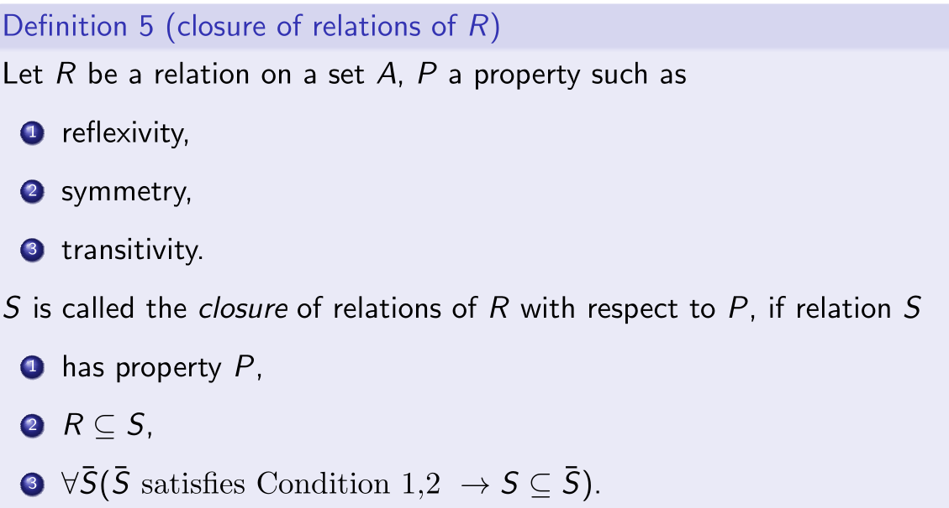
§5.4: Closures of Relations
Note that the closure of a relation with respect to a property may not exist.

Slide 6
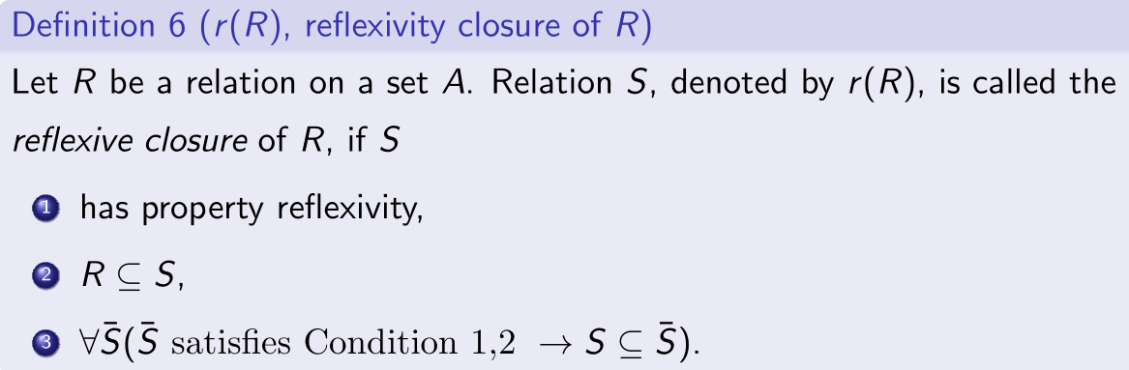
Reflexive closure
Construction. The reflexive closure r(R) of a relation R on A:
r(R)= R ∪ I_{A}
Prove the correctness.

Slide 7
Reflexive closure
Example: A={a, b,c}, Adore={(a,b),(b,c),(c,c)}
r(Adore)=?
{(a,b),(b,c),(c,c),(a,a) ,(b,b),(c,c)}
Example. What is the reflexive closure of the relation R = { (a,b) | a < b } on the set of integers?
The reflexive closure of R is
R U I_{A} = { (a,b) | a<b } U { (a,a) | a ∈ Z }
= {(a,b) | a≤b }

Slide 8
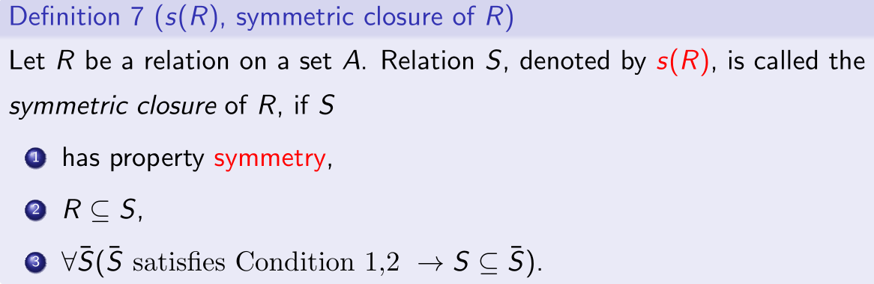

Symmetric closure
Construction. The symmetric closure s(R) of R is:
s(R)= R ∪ R⁻¹ , where

Slide 9
Symmetric closure
Example. Adore={(a,b),(b,c),(c,c)}. s(Adore)=?
s(Adore)= {(a,b),(b,c),(c,c),(b,a), (c,b)}
Example. R = { (a,b) | a>b } , s(R)=?
s(R)= R U R⁻¹ = { (a,b) | a>b } U { (b,a) | a>b}
= { (a,b) | a≠b }

Slide 10
Transitive Closures
10

Slide 11
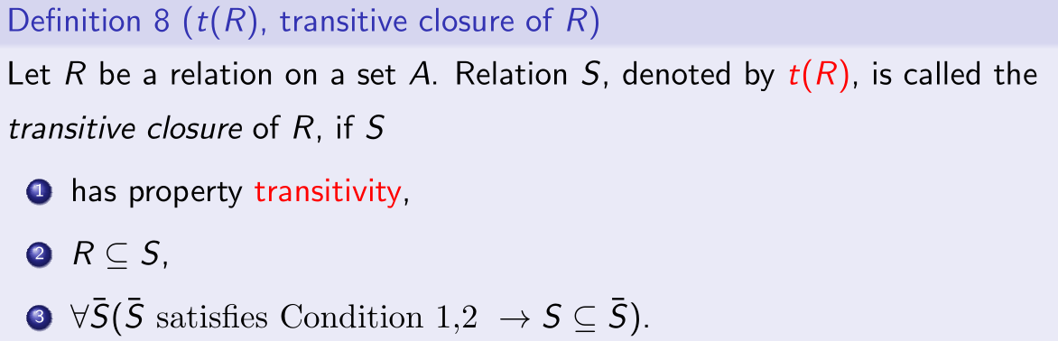
transitive closure

Slide 12
transitive closure
Construction. The transitive closure t(R) of R is obtained by “repeatedly” adding (a,c) to R for each (a,b),(b,c) in R …
Example: Adore={(a,b),(b,c),(c,c)}, t(Adore)=?
t(Adore)= {(a,b),(b,c),(c,c),(a,c)}

Slide 13
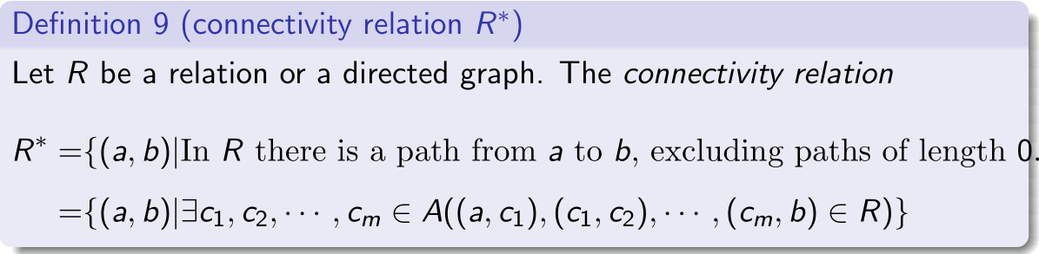
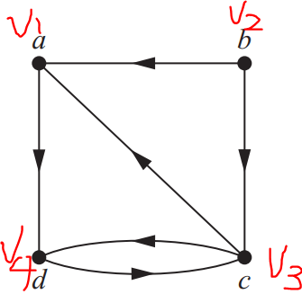
Connectivity Relation
A={1,2,3,4}. What is the R*?

Slide 14
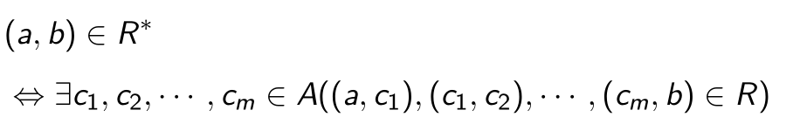

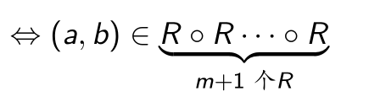

Connectivity Relation

Slide 15
Construction R*
R*= R ∪ R² ∪ R³ ∪ ……?

Slide 16
Example 4
Let R be the relation on the set of all people in the world that contains (a,b) if a has met b, What is R^n, where n is a positive integer greater than one?
R^n consists of those pair (a,b) such that there are people x1,x2,…,xn-1 such that a has met x1, x1 has met x2,…, and xn-1 has met b.

Slide 17
Example 4
Let R be the relation on the set of all people in the world that contains (a,b) if a has met b, What is R*, where n is a positive integer greater than one?
The relation R* contains (a,b) if there is a sequence of people, starting with a and ending with b, such that each person in the sequence has met the next person in the sequence.

Slide 18
Proof of Theorem 2
Theorem: R* = t(R)
Prove R* is transitive
Prove R⊆ R*
Prove R* is the smallest

Slide 19
Proof of Theorem 2
Theorem: R* = t(R)
Proof:
1. Prove R* is transitive:
Suppose (x, y), (y,z) ∈ R*.
(x, y) ∈R^{n} , (y,z) ∈ R^{m}
(x,z) ∈ R^{n+m}
hence (x, z) ∈ R*
2. Following R*’s definition,

Slide 20
Proof of Theorem 2
3. Prove the R* is the minimum.
Suppose R* is not the minimum. Then there exists a transitive superset S :
⇒ ∃(x,y) : (x,y )∈R* ∧ (x,y ) ∉ S.
(x,y )∈ R* ⇒ ∃n : (x,y )∈ R^{n} ⇒ ∃a_{1,} …., a_{n-1} ∈ A:
(x ,a₁) ∈ R, (a₁ ,a₂) ∈ R ，…., (a_{n-1} ,y) ∈ R
R⊆S ⇒ (x ,a₁) ∈ S, (a₁ ,a₂) ∈ S ，…., (a_{n-1} ,y) ∈ S
⇒ ∃n: (x,y )∈ S^{n} (step 4)
S is transitive ⇒S^{n} ⊆S ⇒ (x, y) ∈ S
F (step 1,6)

Slide 21
Transitivity VS Relation Composition
b
R
R
c
a
R
b
S
R
c
a
S o R
21

Slide 22
Transitivity VS Relation Composition
R
R
b2
R
b1
R
R
a
c
R^n = R o R o ..... o R
22

Slide 23
R, t(R)=R*
Note that transitive closure of R is not
b
b
c
c
a
a
Relation R
Transitive closure t(R)=R*
b
c
a
23

Slide 24
Lemma 1
Lemma: Let A be a set such that |A|=n, and let R be a relation on A.
If there is a path of length at least one in R from a to b, then there is such a path with length ≤ n.
Moreover, if a ≠ b, then there is such a path with length ≤ n-1.

Slide 25
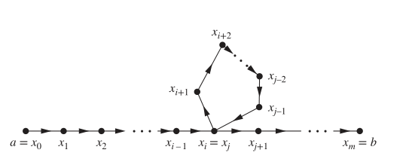
Proof of Lemma 1
Proof:

Slide 26
From Lemma 1, we have:

Slide 27
Theorem 3
Let M_{R} be the zero-one matrix of the relation R on a set with n elements. Then the zero-one matrix of the transitive closure t(R)=R* is
M_{t(R)}=M_{R*}
=M_{R} ∨ M_{R^2} ∨ M_{R^3} ∨ … ∨ M_{R^n}
启示：求t(R) 转化为矩阵 M_{R*}

Slide 28
Example 7

Slide 29
Algorithm of Computing TC
Procedure transitive closure (M_{R*}: zero-one nxn matrices)
A:= M
B:=A
for i:=2 to n
begin
A:=A * M
B:=B + A
end // B is M_{R*}
Cost: O(n⁴ ) bit operations
Cost: O(n³ ) bit operations
Cost: O(n² ) bit operations

Slide 30
Warshall’s Algorithm
30

Slide 31
Fast algorithms are available for calculating R*, especially Warshall’s algorithm (also called Roy-Warshall algorithm)
FYI: this algorithm uses a matrix representation.

Slide 32
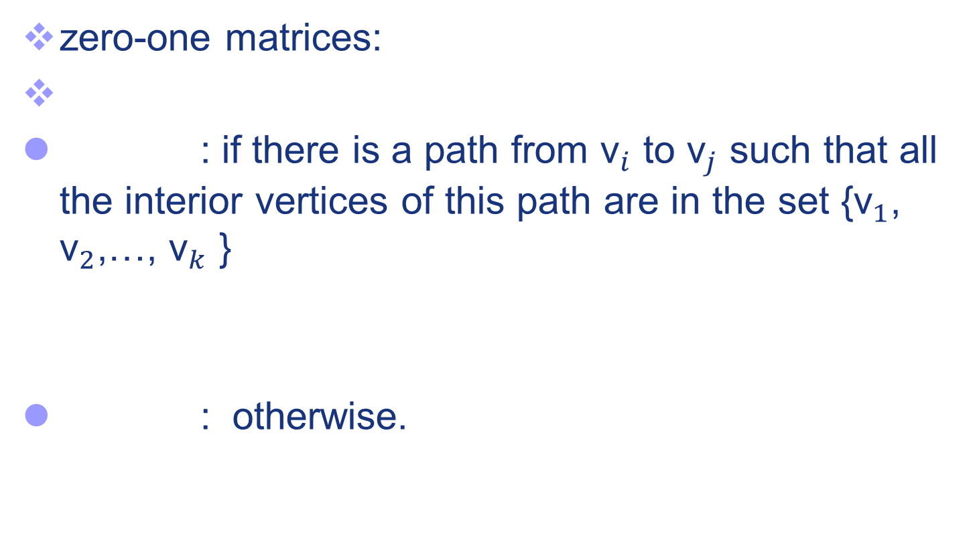
Idea of Warshall’s Algorithm
zero-one matrices:
: if there is a path from ${\text{v}}_{i}$ to ${\text{v}}_{j}$ such that all the interior vertices of this path are in the set {${\text{v}}_{1}$, ${\text{v}}_{2}$,…, ${\text{v}}_{k}$ }
: otherwise.

Slide 33
Idea of Warshall’s Algorithm
?
Y
Y

Slide 34
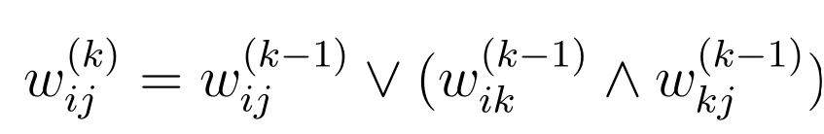
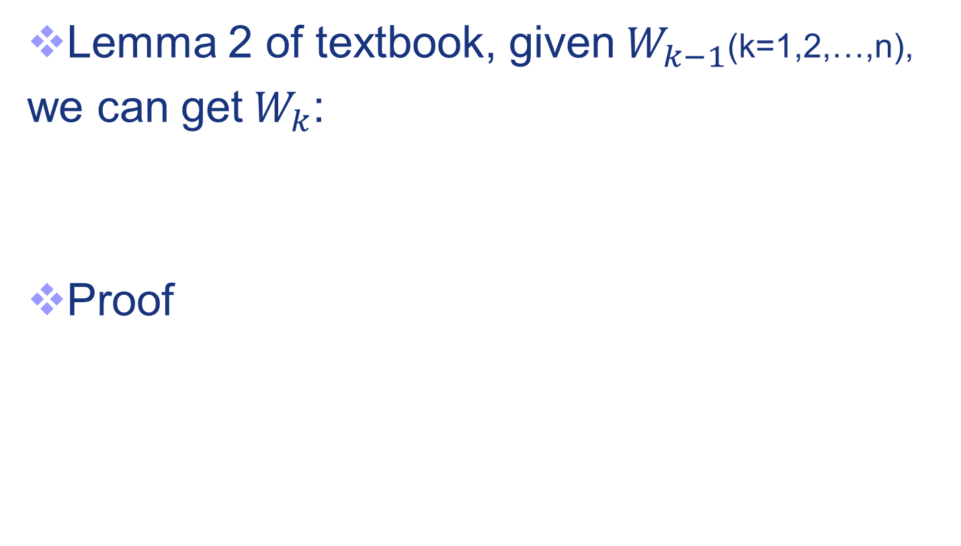
How to compute W(k)
Lemma 2 of textbook, given${ W}_{k−1}$(k=1,2,…,n),
we can get$W_{k}$:
Proof

Slide 35
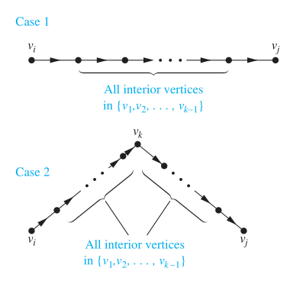

Slide 36
Example 8

Slide 37
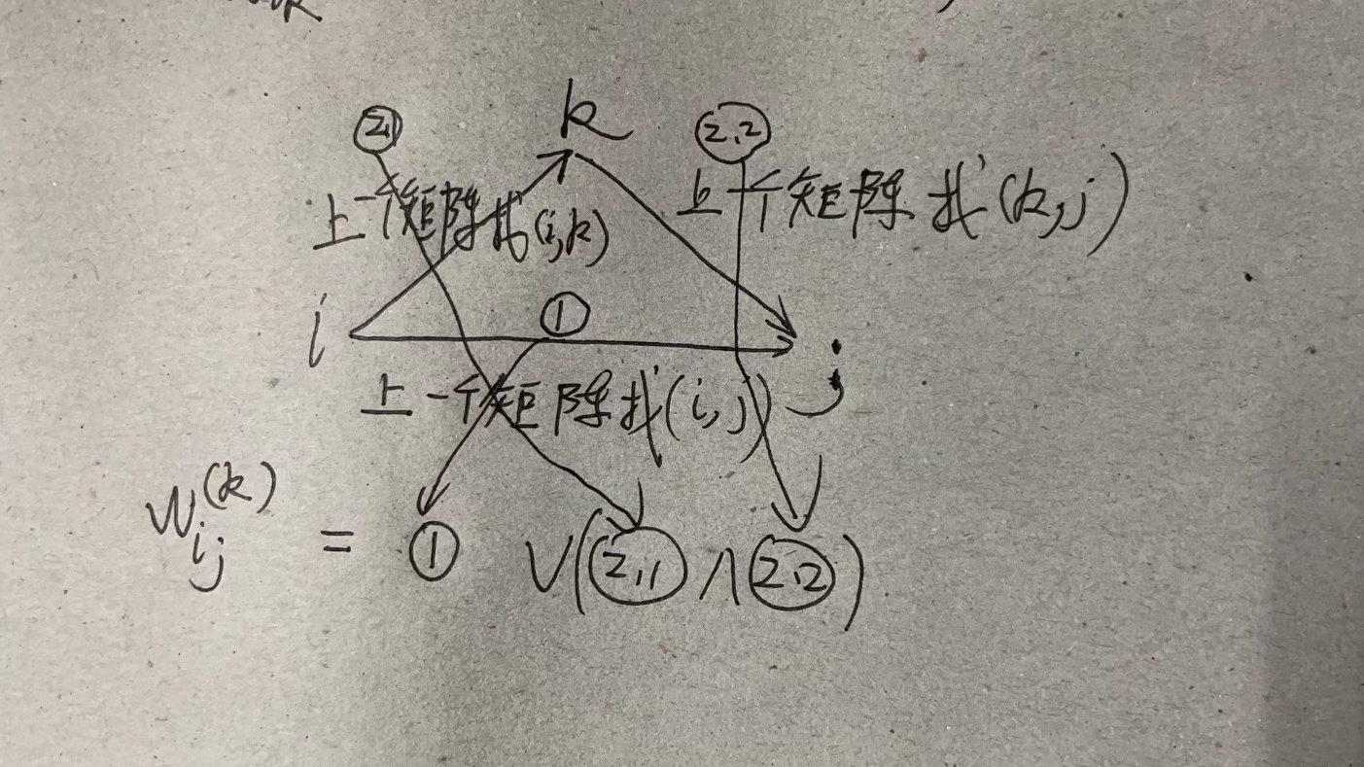
小技巧

Slide 38
Example 8

Slide 39
Example 8

Slide 40
Example 8

Slide 41
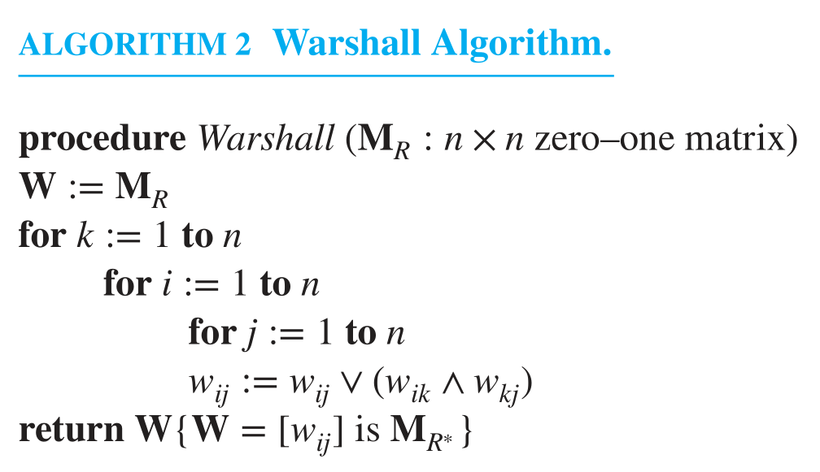
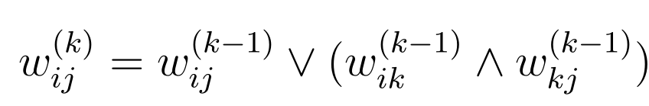
Warshall Algorithm
O(n^3 ) bit operations

Slide 42
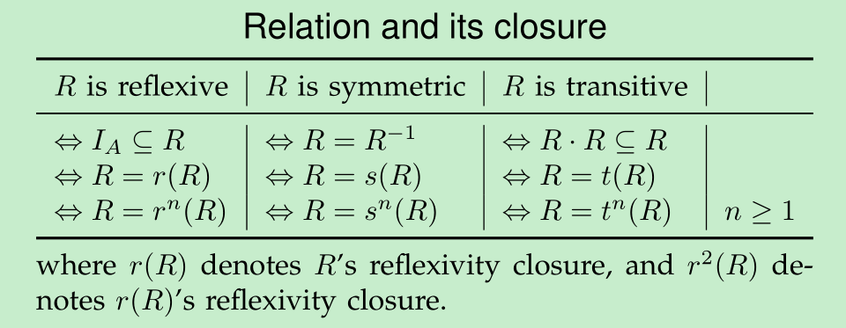
Please prove the propositions described in the following table.

Slide 43


历史上的考题
Considering the relation R on A={1,2,3,4} and its adjacency matrix $M_{A}$, please apply Warshall’s algorithm to calculate the transitive closure of R by completing the matrixes of W1-W4.
$$W0=M_{A}=\left[\begin{matrix}1 & \begin{matrix}0 & \begin{matrix}0 & 1\end{matrix}\end{matrix} \\ \begin{matrix}1 \\ 1 \\ 0\end{matrix} & \begin{matrix}\begin{matrix}0 \\ 1 \\ 1\end{matrix} & \begin{matrix}\begin{matrix}1 \\ 0 \\ 0\end{matrix} & \begin{matrix}0 \\ 1 \\ 0\end{matrix}\end{matrix}\end{matrix}\end{matrix}\right]$$

Slide 44
Summary
The technology route of this section:
Most confusions come from the definitions of transitivity, and notations:

Slide 45
Homework
1, 9 a) f), 11, 13

Slide 46
End of Section 7.4
Click to edit company slogan .
46

